Slide 1
MACHINE LEARNING CLASSIFICATION MODEL
DIABETES IN U.S. COUNTIES
June 2020
Francis Morales

Slide 2
PROJECT OBJECTIVE
Determine the level of population with Diabetes in counties of the US to guide retailers on determining their sugar conscious merchandise stock.

Slide 3




DIABETES IN THE UNITED STATES
34.2 Million
7th
1.5 Million
leading
cause of death
people 18 years old or older diagnosed with diabetes in 2018
1 in every 10 people has Diabetes
DIABETES MANAGEMENT

Slide 4






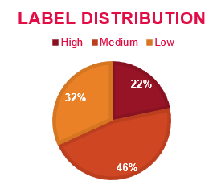

DATASET
820 counties from 48 states (26% of counties)
Excluded Hawaii and Alaska from study
50 different features: economic features, demographics, geographic coordinates, weather components & food access
7 Data Sources: Web scraping, API & data download
Diabetes labels – by population with diabetes percentage
Low: 0% to 8.5%
Medium: 8.6% to 11.6%
High: more than 11.6%

Slide 5

METHODOLOGY
MODEL OVERVIEW
Model Training & Evaluation
Delivery of Results
Data Mining & Data Cleaning
Model Training & Evaluation
Delivery of Results
Data Mining & Data Cleaning
Exploratory Data Analysis
Exploratory Data Analysis
A Support Vector Machine Classification Model that predicts the level of population with Diabetes of a county with 70.7% accuracy.
Classifier | Accuracy | Precision (wgt avg) | Recall (wgt avg)
Random Forest | 0.6747 | 0.67 | 0.67
KNN | 0.6422 | 0.65 | 0.64
SVM | 0.7073 | 0.71 | 0.71
XGBoost | 0.7073 | 0.70 | 0.71
Trained models using Pipelines & Grid search:
Random Forest
SVM
K-Nearest Neighbors
Adaboost/Gradient Boosting/ XGBClassifier

Slide 6



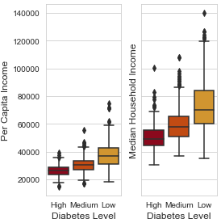
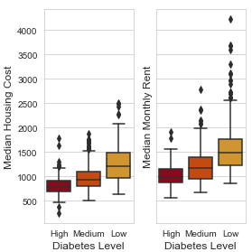
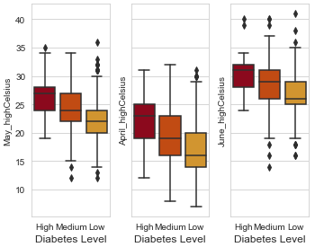
MOST INFLUENTIAL FEATURES
Per Capita Income
Median Household Income
Median Housing Costs
More income, less diabetes
Higher living costs, less diabetes
Milder Spring temperatures, less diabetes
Monthly Rent
May High Temperature
April High Temperature
June High Temperature
1
2
3
4
5
6
7

Slide 7
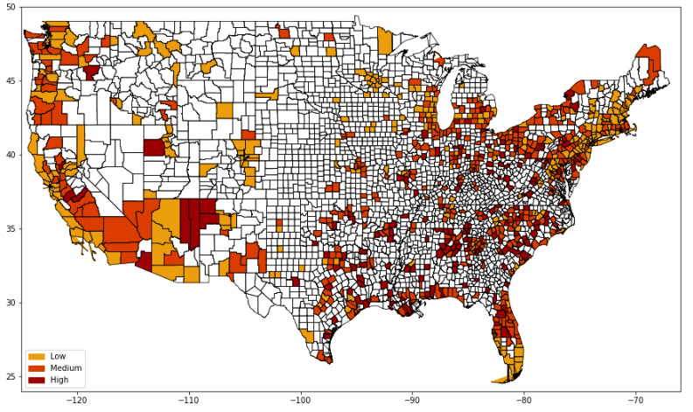
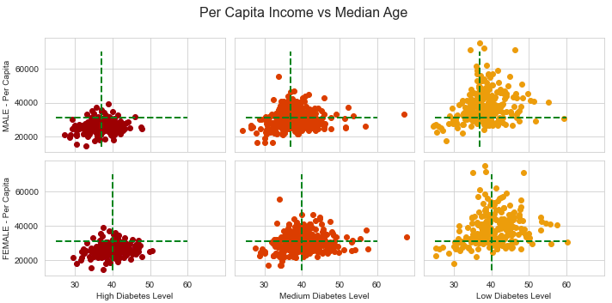
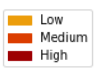
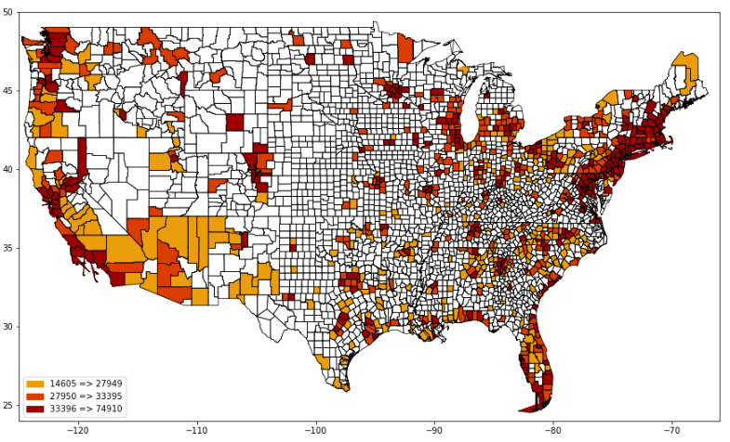
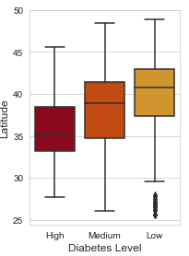
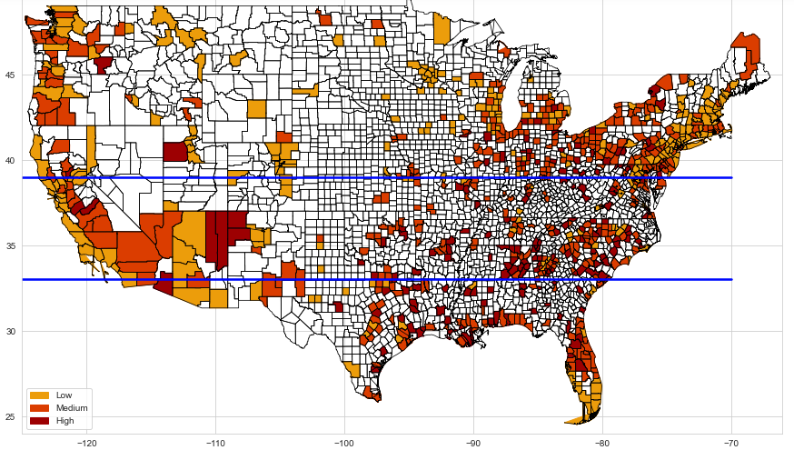
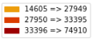
PER CAPITA INCOME VS MEDIAN AGE
DIABETES LEVEL
LATITIDE
PER CAPITA

Slide 8



RECOMMENDATIONS
Use the Machine Learning classification model to identify the level of diabetes of your store’s location
Carry affordable diabetic friendly items in stock in counties with High levels of diabetes
Invest in labeling diabetic-friendly items in counties with High levels of diabetes as more than 12% of the customers that walk in will be interested in that selection

Slide 9
Thanks!

Slide 10
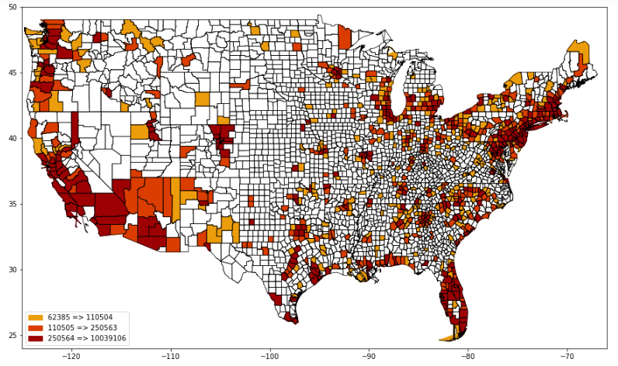
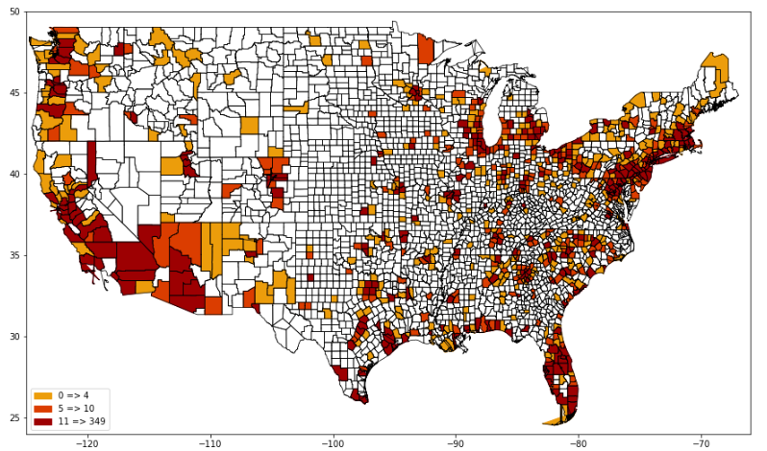
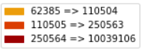
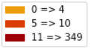
APPENDIX A
DIABETES LEVEL
PER CAPITA
POPULATION
NUMBER OF MCDONALD’S

Slide 11
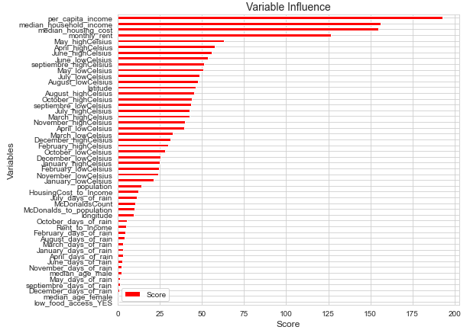
APPENDIX B

